Slide 1
Why Choose UCalgary for Your Graduate Studies
September, 2022

Slide 2

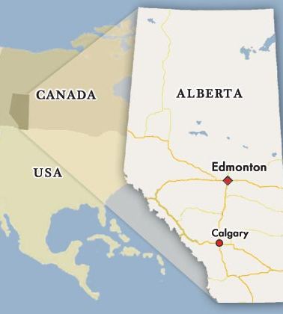
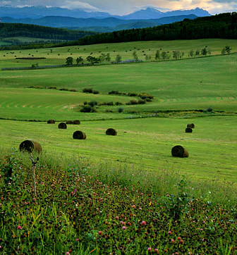
Alberta, Canada
4th largest Canadian province
9% of Canada’s population
Canada’s wealthiest province
Immense natural resources
Dynamic and diverse economy
Highly educated and skilled workforce
Notes:
Canada’s wealthiest province according to Stats Canada 2009 data.
3. 4 million people live in the province of Alberta

Slide 3

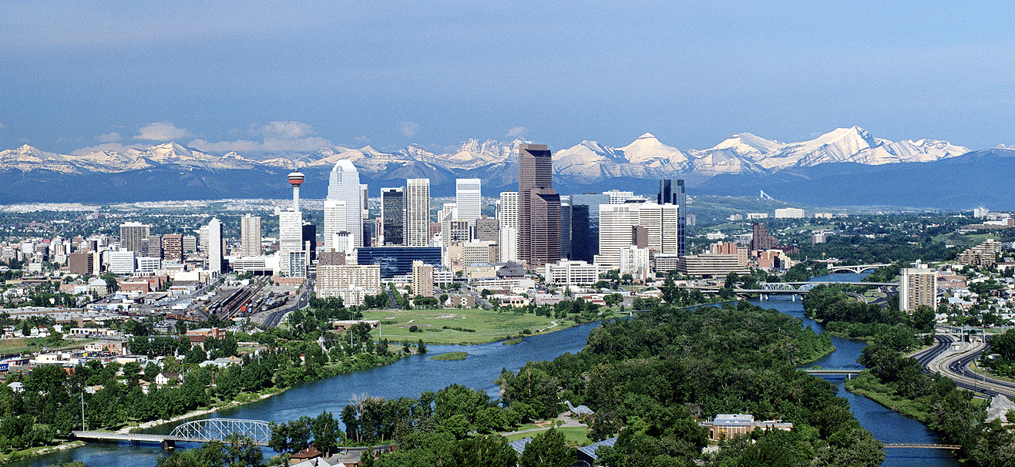
What You Should Know about Calgary
#1 world's cleanest city
#2 city worldwide for prosperity
5th most livable city in the world
Energy capital of Canada
Highest concentration of engineers in Canada
Canada’s most educated
Safe, friendly, diverse, multi-cultural
Good sized city, not too big, not too small
Notes:
http://www.calgarysun.com/2014/02/26/calgary-the-number-two-city-in-the-world-prosperity-ranking
http://www.huffingtonpost.ca/2013/05/18/calgary-worlds-cleanest-city_n_3299545.html
http://www.economist.com/blogs/graphicdetail/2014/08/daily-chart-13

Slide 4

Universities in Canada
Quality of Canadian education is high
Lower tuition fees and living costs than in the U.S., U.K. and Australia
Advanced facilities and learning technology
Safe, secure, clean
Strong Canadian economy helps graduates transition into careers

Slide 5
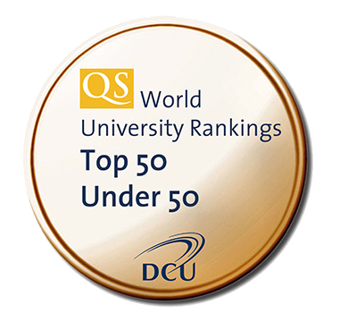


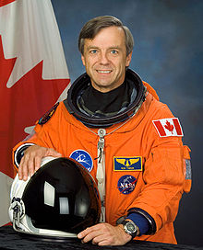
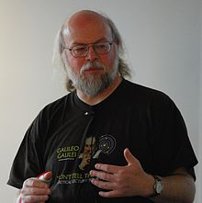
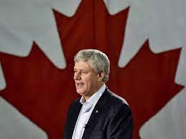
University of Calgary Key Statistics
Member of Canada’s U15
research-intensive universities
~33,000 students in 100+ programs
85+ research institutes and
centres
5 campuses, 14 faculties
53 teaching departments
$380 Million sponsored
Research Income (#5 in Canada)
170,000⁺ alumni in 152⁺ countries
Robert Thirsk
Astronaut
James Gosling
Dr. Java
Stephen Harper
22nd Prime Minister
Notes:
#1 in Canada result comes from:
- Quacquarelli Symonds (QS) World University Rankings 50 Under 50 (2013/14)
- Times Higher Education (THE) 100 Under 50 (May 2014)
#2 in North America result comes from:
Quacquarelli Symonds (QS) World University Rankings 50 Under 50 (2013/14)
(we were #5 in North America according to Times Higher Education (THE) 100 Under 50 (May 2014))
NEW! #9 in the world result comes from:
Quacquarelli Symonds (QS) World University Rankings 50 Under 50 (2014/15) – released Sept 23 (up from 13 in 2013/14)
One of only 9 to receive 5 star-star status
Globally, our results have improved as follows:
- QS: 17 (2012), 16 (2013), 13 (2014)
THE: 28 (2012), 23 (2013), 19 (2014)
Breaking news!
- Quacquarelli Symonds (QS) World University Rankings 50 Under 50 (2014/15) places us at #171 worldwide (released Sept 15, 2014). This is up from #201 last year and #214 the year before that.

Slide 6
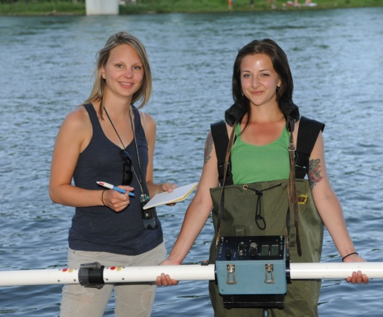
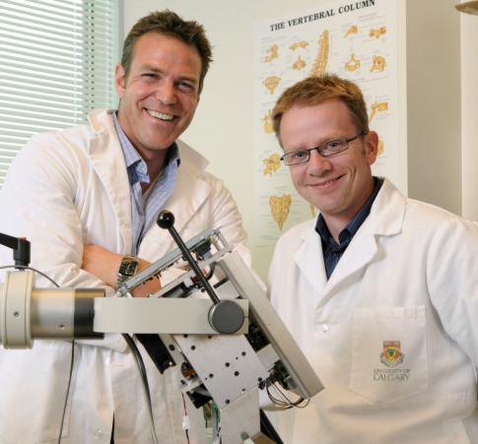

Faculties
Arts
Werklund School of Education
Environmental Design
Graduate Studies
Haskayne School of Business
Kinesiology
Law
Cumming School of Medicine
Nursing
Nursing (Qatar)
Schulich School of Engineering
Science
Social Work
Veterinary Medicine

Slide 7
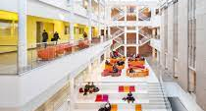
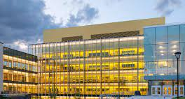
Schulich School of Engineering
舒立克工程学院
Biomedical
Chemical and Petroleum
Civil
Electrical and Computer Software
Environmental
Geomatics
Mechanical and Manufacturing

Slide 8
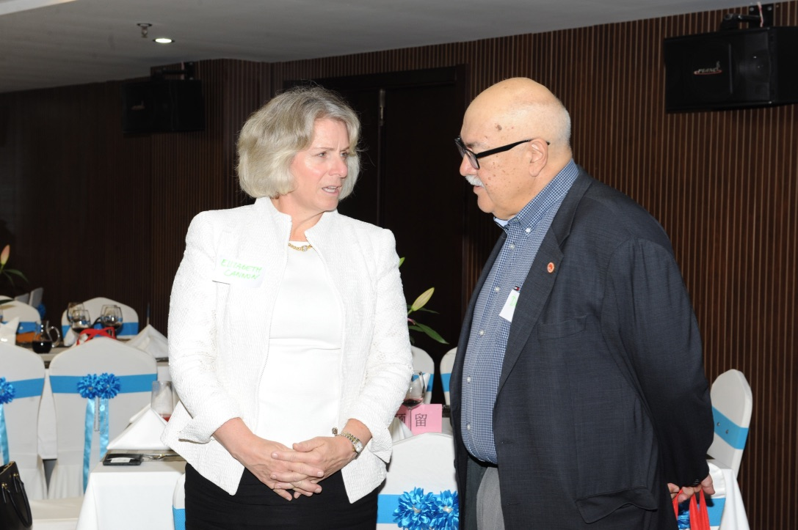
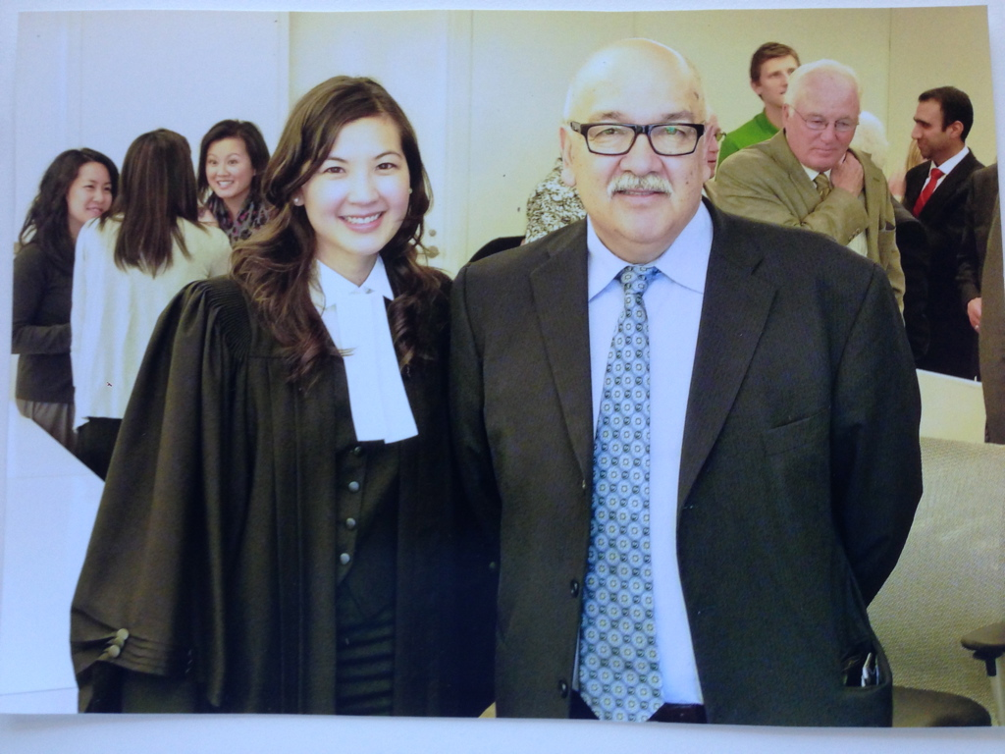
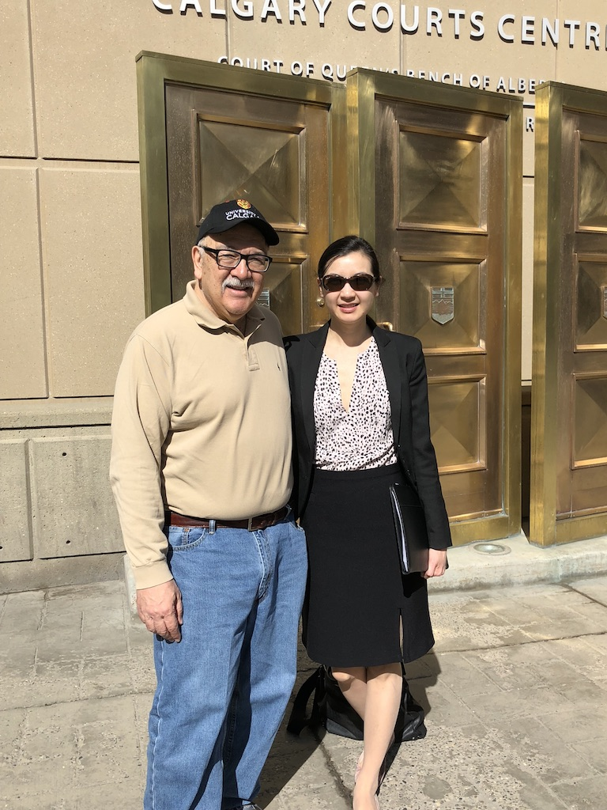
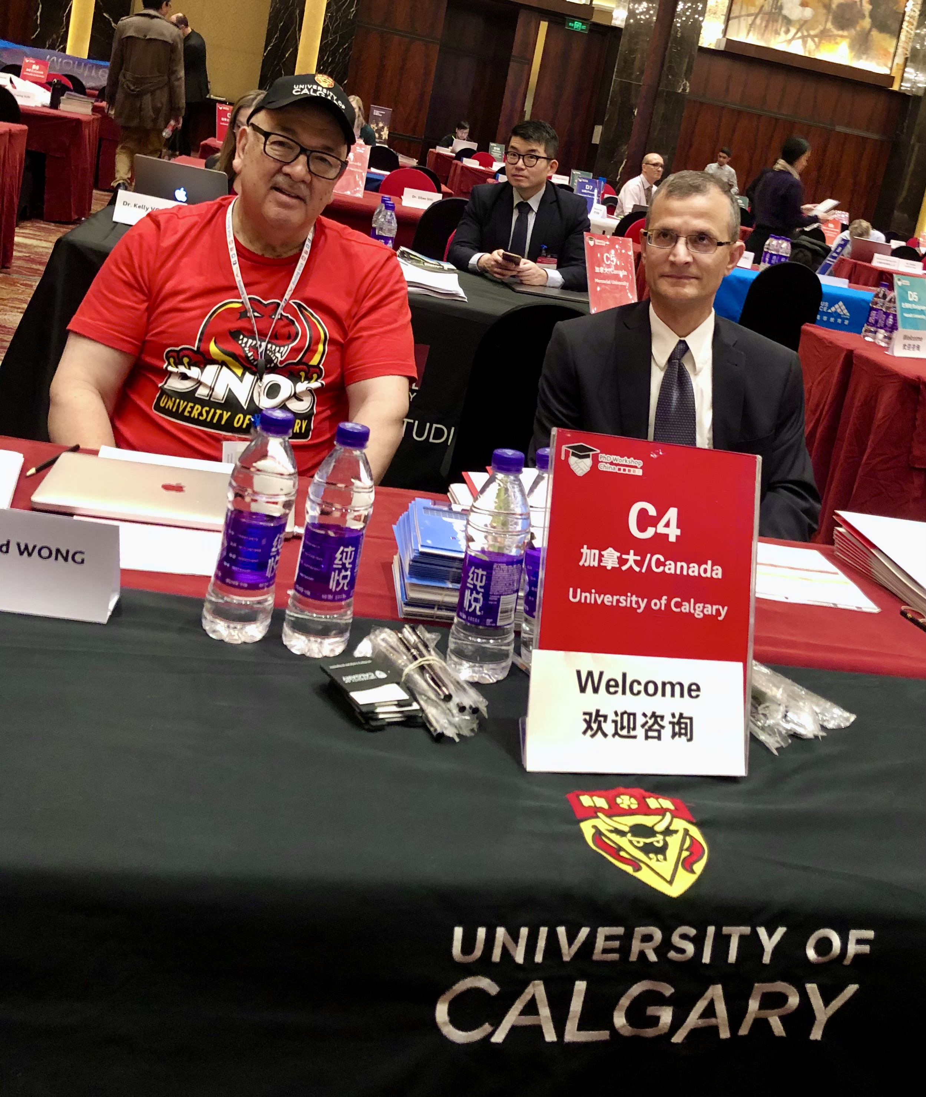
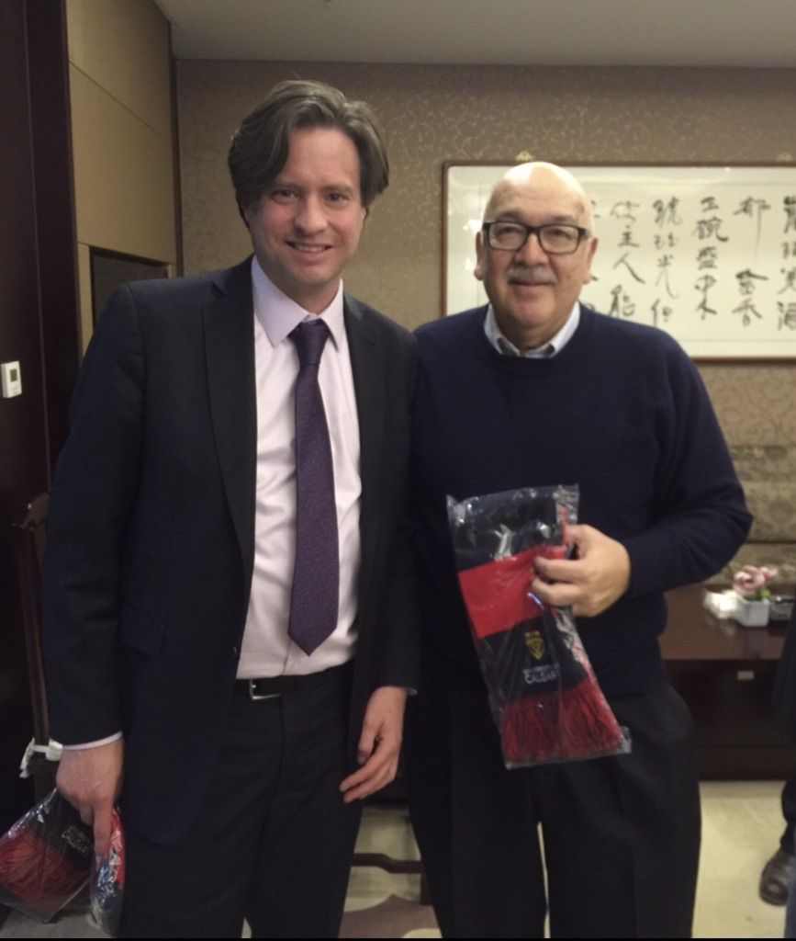
About David Wong
黄伟棠巧黄孙桥博士孙乔
Born in Canada
Raised in Calgary
  University of Calgary Grad
  Bachelor Commerce
  MBA
Provincial Government 10 years
Federal Government 25 years
  Diplomat
  Canada Embassy BJ 14 years
University of Calgary – Schulich School of Engineering
-China Representative 2018

Slide 9
Biomedical Engineering BME
生物工程
BME uses engineering tools to solve animals/humans problems
Stem Cell research, pharmaceutical, biomaterials, food eng.
Bioinformatics, cellular & tissue eng., genomics
Work in industry, academia, government improving therapeutics
Inter-disciplines ie: kinesiology, physical sciences, medicine or life sciences
Gain hands-on experience at various active university and hospital based research centres

Slide 10
Chemical & Petroleum Engineering
化学和石油工程
The MEng in Chemical and Petroleum Engineering gives you a competitive advantage,
this program also gives you upward mobility in pharmaceuticals, food products, metals, fertilizers, synthetic materials etc.
graduates will have a balance of the fundamental knowledge and practical skills required to work in process engineering, petroleum reservoirs, petroleum production, environmental engineering, software development and/or documentation for chemical process/petroleum reservoir simulation software, chemical sales,

Slide 11
Civil Engineering
土木工程
engineering sectors, such as engineering consultancy,
project management and construction,
sustainability and technology,
government and policy makers, NGOs,
resource industries and public utilities, railroads, manufacturing
MEng in Civil Engineering graduates will have a balance of the fundamental knowledge and practical skills required to work in civil engineering in Canada, and worldwide.

Slide 12
Electrical and Computer Engineering
电子与计算机工程
Depending on your focus, you could work as an electrical engineer, software engineer or computer engineer.
The program can often be completed in one to two years of full-time study. A course-based professional degree, You’ll be equipped to find increasingly digitized engineering solutions.
Get up to speed on programming fundamentals through our customized boot-camp
Experience a team-based learning approach
Access free tutoring and academic support from leaders in the field

Slide 14
Software Engineering
Very popular program, so apply early!
Requires Undergraduate Software Engineering Degree
Or take a a 3 month “Boot Camp” prerequisite
Gain advanced level software engineering skills
Big Data Analytics, Web Development, Systems Designing
Professional Development in Project Management
Innovation and Entrepreneurship

Slide 15
Environmental Engineering
环境工程
Water Pollution Assessment and Control
Industrial & Hazardous Waste Treatment
Landfill Engineering & Greenhous Gas Control
Air Pollution Assessment and Control
Renewable Energy – Solar and Wind
Environmental Modelling and Sustainable Development

Slide 16
Geomatics Engineering
测绘工程
Only one of four Canadian Universities providing Geomatics
80% of information gathered today has to do with location
UAV Unmanned Aerial Vehicles – drones
17:1 ratio of students to instructors
Emergency locators for first responders
“Positioning You For Success”

Slide 17


Department of Geomatics Engineering
https://schulich.ucalgary.ca/geomatics
• The largest program in Canada (out of 4 programs)
• A renowned world leader in education and research
• Diverse program in forefront of technology
• High employment, internship & scholarship opportunities
• Small classes & enhanced student experiences
• Fully accredited degree by CEAB & CBEPS
Department of Geomatics Engineering

Slide 18
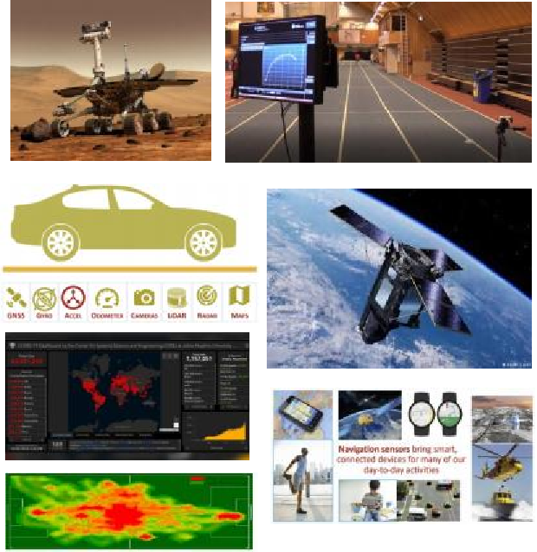
Department of Geomatics Engineering https://schulich.ucalgary.ca/geomatics
Research areas:
• Geodesy, remote sensing and Earth observation
• Digital imaging systems
• Positioning, navigation and wireless location
• GIScience and land tenure
Enhance your degree:
• Software Engineering Minor
• Aerospace Engineering Minor
• Biomedical Engineering Minor
• Digital Engineering Minor
• Energy and Environment Minor
• Concentration in Cadastral Surveying
• Geomatics/BComm Combined Program
Department of Geomatics Engineering

Slide 19
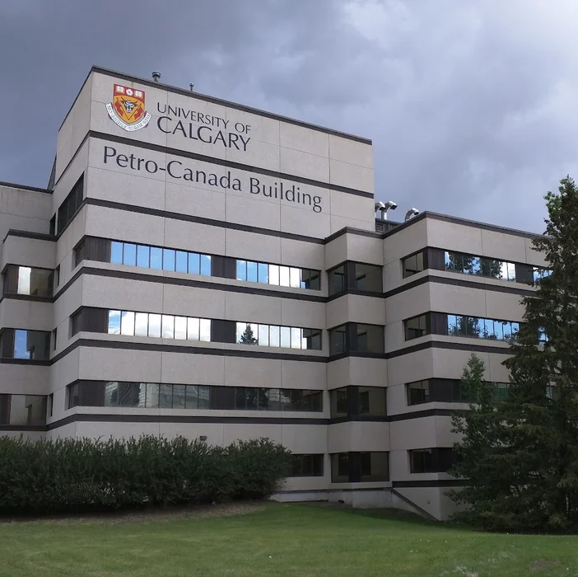
Department of Mechanical and Manufacturing Engineering
机械制造工程
41 Academics
4 Research chairs
150 graduate students
800 undergraduate students
$30M research funding

Slide 20

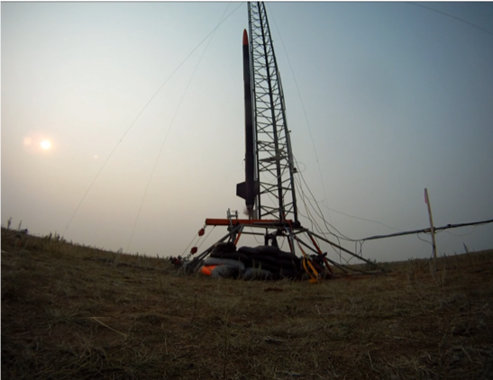

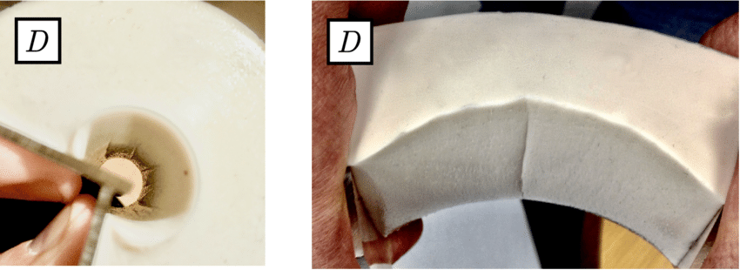
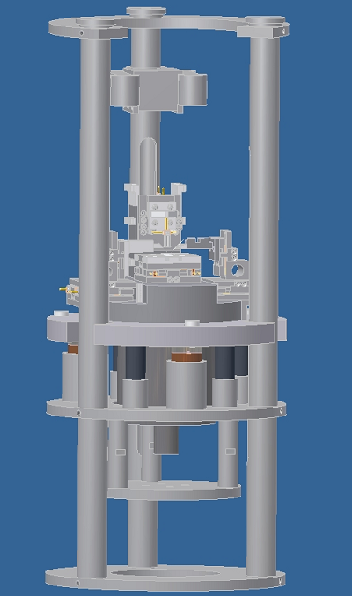
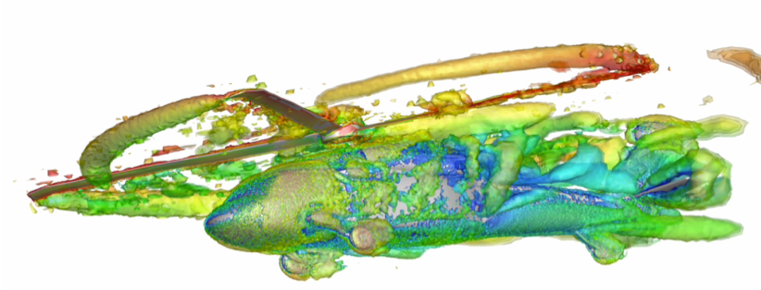
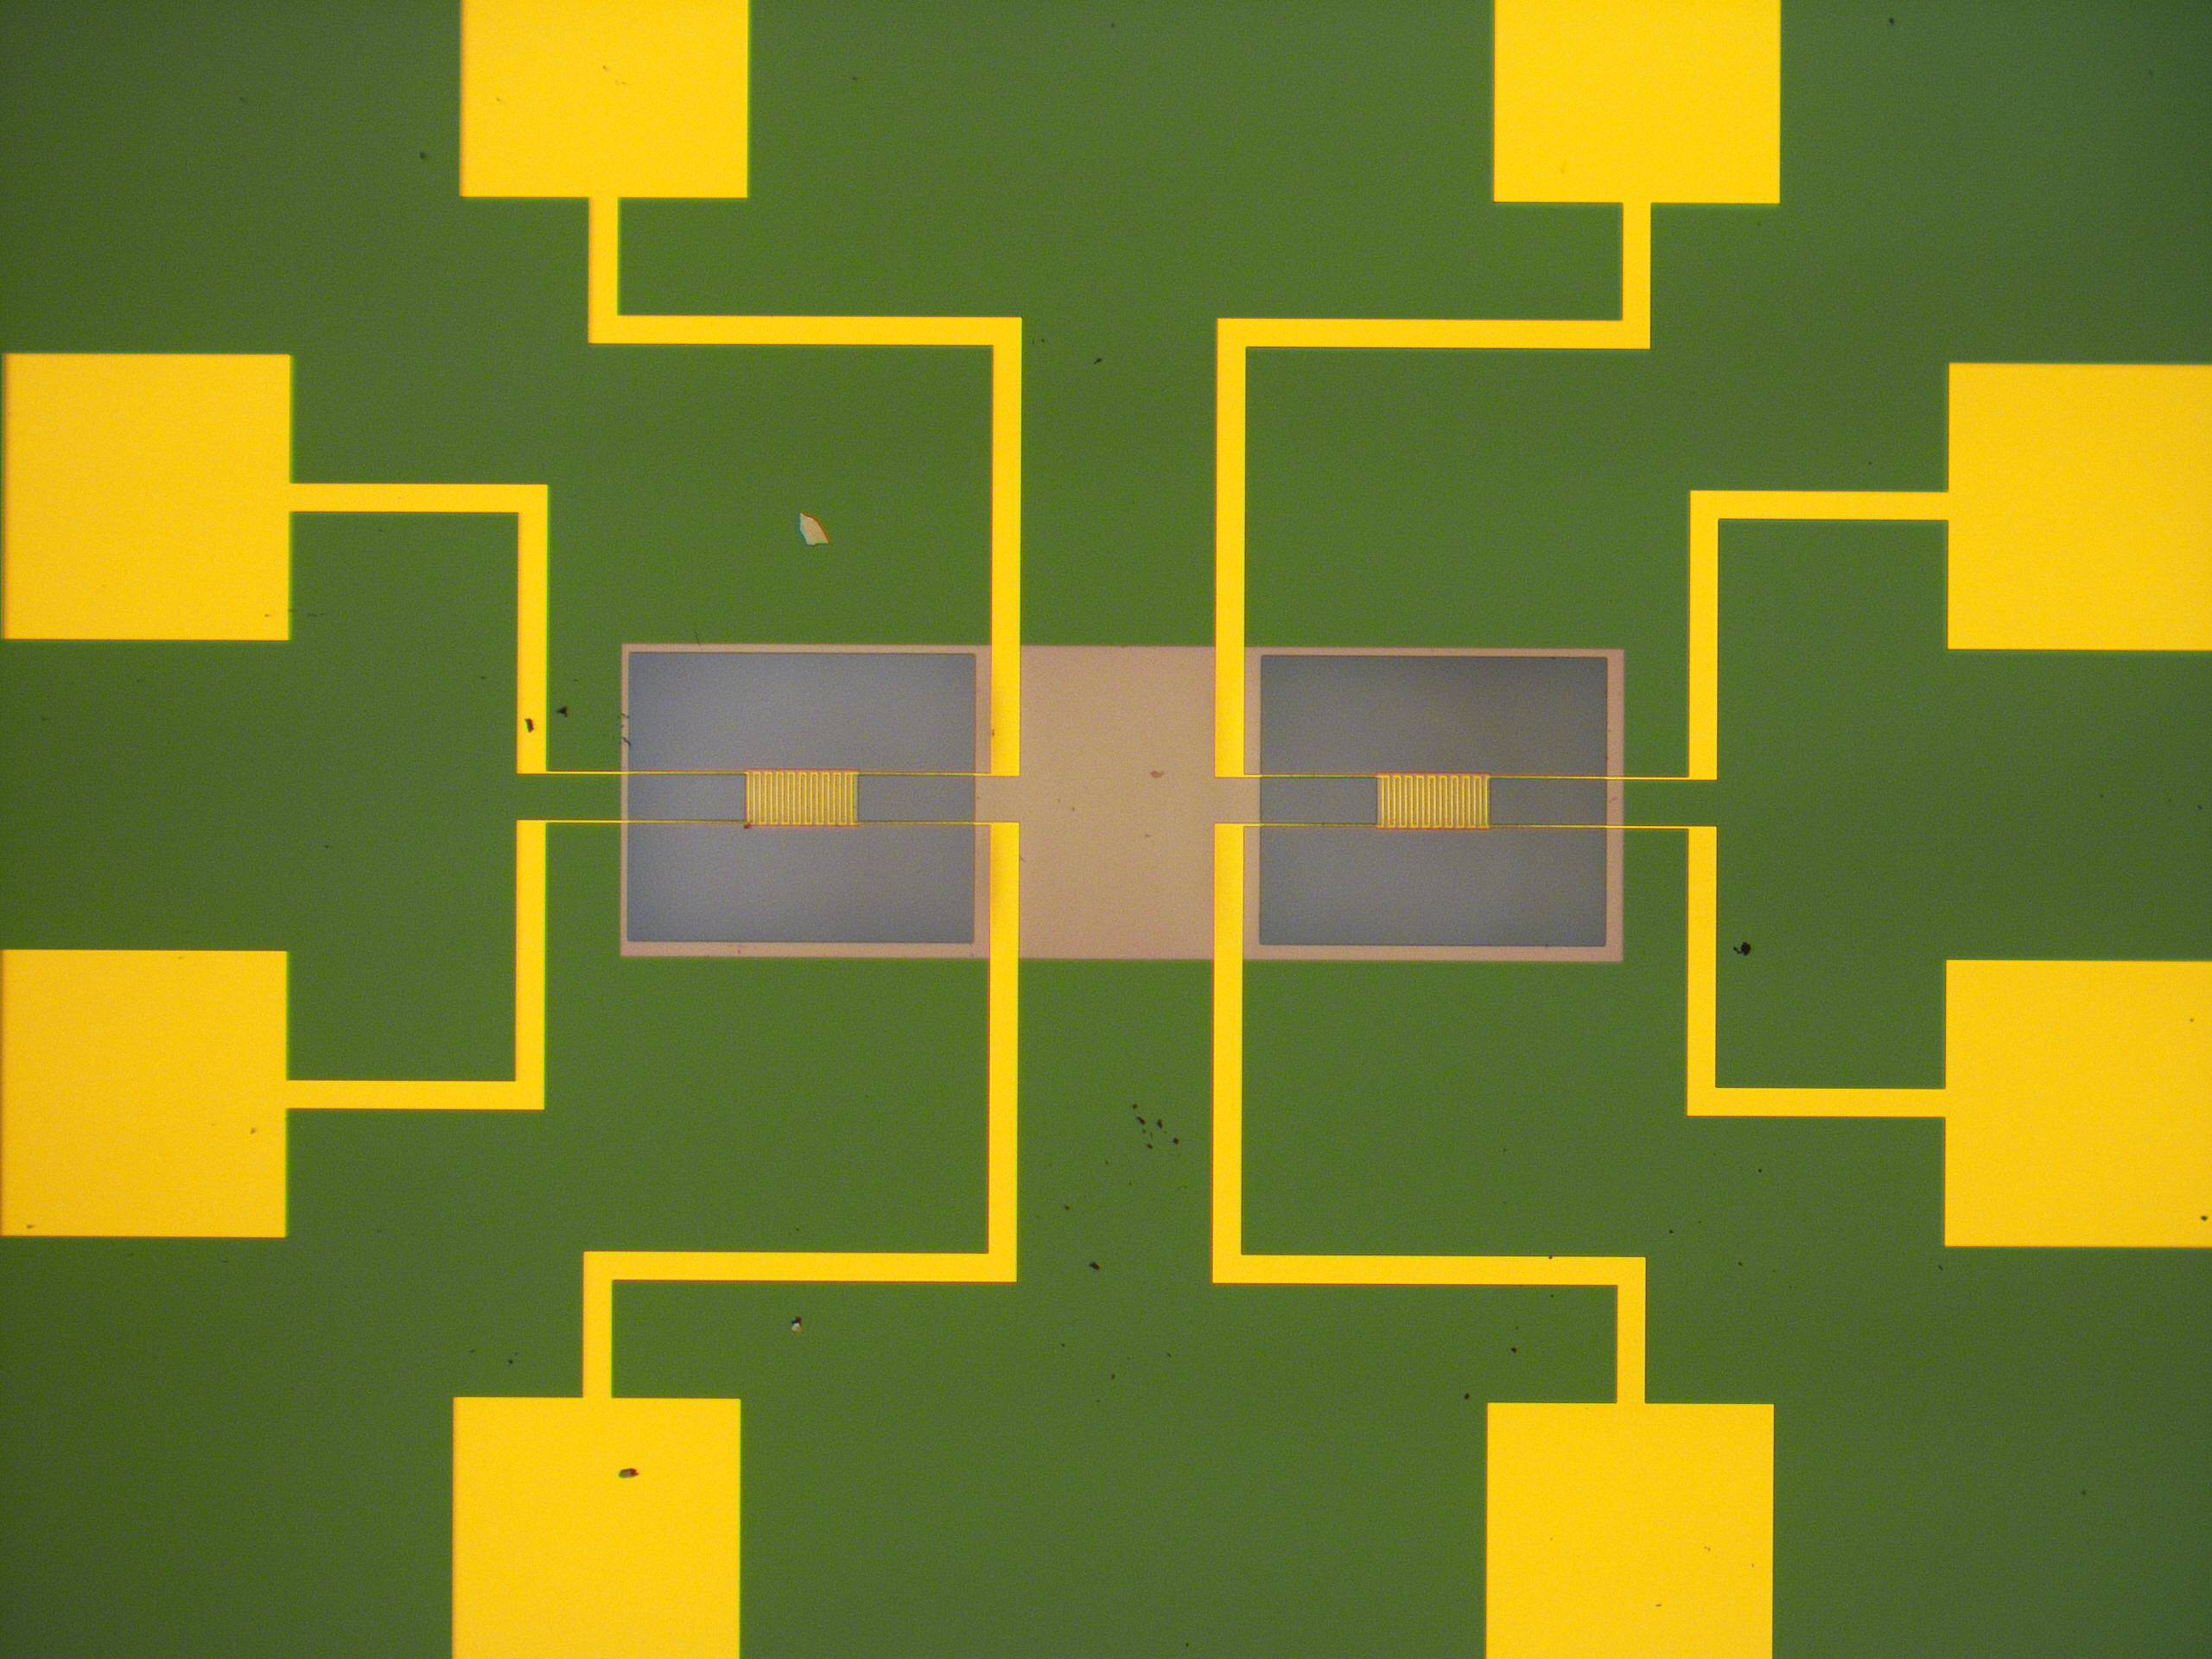
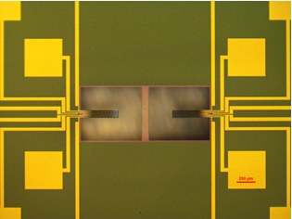

Areas of Strength
Culture of Respect Inclusion, Collaboration & Creativity
Advanced Materials & Manufacturing
Material Modeling & Applied Mechanics
Environmental Sensing & Monitoring
Engineering Education Innovation
Mechatronics Digital Twin & Control
Aerospace & Renewable Sustainable Energy Systems

Slide 21

School Highlights
Over 200 faculty members; 4200 undergraduate students; 2000 graduate students
Five year strategic priority
  Support student success
  Conduct research that makes a difference
  Foster diversity
Research fund at over 30 million/year
Over 40 Research Chairs
Strong ties to industry

Slide 22
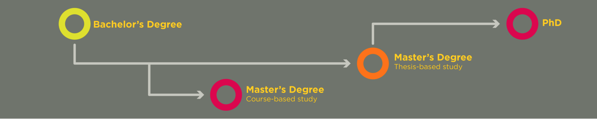
Selecting Your Graduate Program
Research-based options
Course-based options
1, 2, or 4-year programs

Slide 23

Master of Engineering (MEng)工程研究生
Full-time (Part-time options available)
Course-based
Program duration 1 to 2 years
No financial support
Graduates work in industry

Slide 24
Master of Science (MSc)工程研究生
Full-time (Part-time options available)
Research-based (requires a supervisor)
Program duration 2 to 4 years
Guaranteed funding
Graduates work in industry

Slide 25

Doctor of Philosophy (PhD)博士学位
Full-time with candidacy exam
Research-based (requires a supervisor)
4 years with MSc, 5 without
Guaranteed funding
Graduates work in academia or industry

Slide 26
English Language Requirements
TOEFL score of at least 86 with no section below 20
IELTS minimum score 6.5 with no section less than 6

Slide 27
Tuition
The most up-to-date details on tuition can be found here
https://www.ucalgary.ca/pubs/calendar/current/p-1-2

Slide 28

Calgary International Summer Program
Designed specifically for international students
4-week program during the summer
Academic courses and English Language Training
Engineering classes available in this program:
  Introduction to Energy and Environment
  Project Management
卡尔加里国际暑期项目

Slide 29
Thank you 谢谢
如果有问题，请联系我们：
孙巧博士，Schulich工程学院副院长
Email: qsun@ucalgary.ca
黄伟棠先生，卡尔加里大学中国代表
Email: David.wong5@ucalgary.ca
Wechat: 13718138391

