Slide 1

Visit at China University of Petroleum
Werner Nau, Interim Provost, Vice President Academic Operations
Maja Feldt, Managing Director
China University of Petroleum, November 11th 2023

Slide 2


Constructor University is a private, English-speaking campus university
We are committed to excellence and innovation in research, teaching and knowledge transfer with a modern infrastructure and a professional
environment to study, live and work.

Slide 3
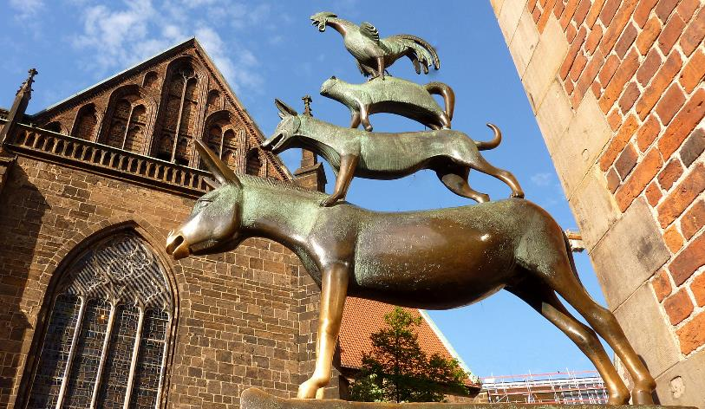


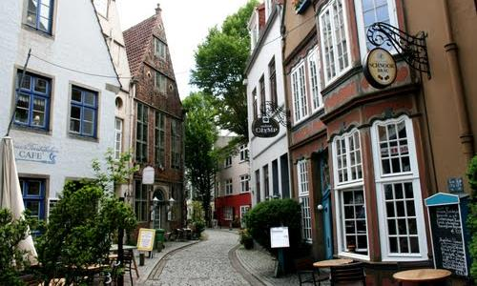
Bremen, Germany

Slide 4
Constructor University in Numbers
€ 60 Mio. revenue per year
1800 students,
500 employees
2 pre-degree
19 Bachelor 6 graduate programs
6 spin-offs and start-up companies on campus
80 professors & lecturers
> 380 publications per year
> 20000 citations per year
45 % students from developing and emerging economies
120
different countries of origin
2,300 persons live / learn / work on campus
>30 sports, culture & other cooperation projects

Slide 5
Strategic Positioning
Residential university – students from all over the World live and learn in 4 colleges
English as language of instruction
Comprehensive university – covers the full academic value chain
Broad range of disciplines in teaching and research
Close relationship between faculty and students
Early research involvement of students
4 COLLEGES ON CAMPUS

Slide 6
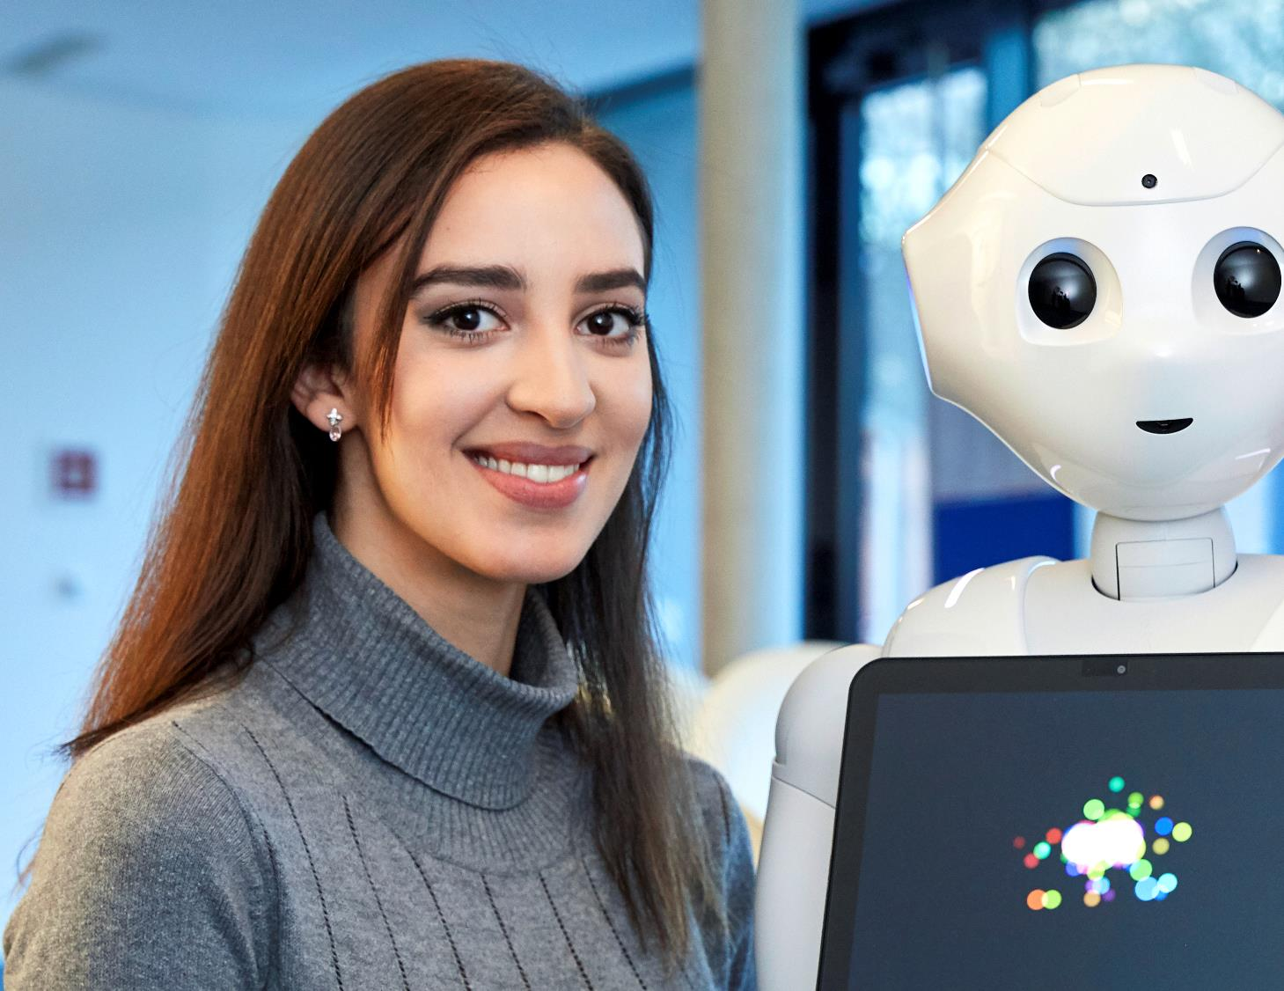
School of
Computer Science and Engineering
    Bachelor Programs as of Fall 2023:
    Computer Science
    Applied Computer Science (online program)
    Electrical and Computer Engineering
    Robotics and Intelligent Systems

Slide 7

School of
Science
  Bachelor Programs as of Fall 2023:
  Mathematics, Modeling and Data Analytics
  Biochemistry and Cell Biology
  Chemistry and Biotechnology
  Earth Sciences and Sustainable Management of Environmental Resources
  Medicinal Chemistry and Chemical Biology
  Physics and Data Science

Slide 8

School of Business, Social and Decision Sciences
  Bachelor Programs as of Fall 2023
    Global Economics and Management
    Management, Decisions and Data Analytics
    Industrial Engineering and Management
    International Business Administration
    International Relations: Politics and History
    Integrated Social and Cognitive Psychology
    Management, Decisions and Data Analytics

Slide 9
Constructor University Programs
Pre-degree programs:
International Foundation Year
“Soft Landing” spring semester intake
19 Bachelor (BSc) Programs (intake 2023):
Computer Science = CS
Applied Computer Science (online) = ACS
Software, Data and Technology = SDT
Electrical & Computer Engineering = ECE
Robotics & Intelligent Systems = RIS
Mathematics, Modeling and Data Analytics = MMDA
Biochemistry & Cell Biology = BCCB
Chemistry & Biotechnology = CBT
Earth Sciences & Sustainable Management of
Environmental Resources = ESSMER
Medicinal Chemistry & Chemical Biology = MCCB
Physics & Data Science = PHDS
Global Economics & Management** = GEM
Management, Decisions & Data Analytics = MDDA
Industrial Engineering & Management = IEM
Industrial Engineering & Management (online) = IEM
International Business Administration** = IBA
International Business Administration (online)** = IBA
International Relations: Politics & History** = IRPH
Integrated Social & Cognitive Psychology = ISCP
** Bachelor of Arts program
Our Master (MSc) Programs (intake 2023):
Data Science for Society & Business = DSSB
Advanced Software Technology = AST
Computer Science & Software Engineering* = CSSE
Data Engineering = DE
Supply Chain Management = SCM
* Dual-campus program with Constructor Institute in Schaffhausen
PhD Degrees
awarded in more than 30 disciplines

Slide 10
The
Remodeling
Education –
New Programs
New Formats
New Track
New in 2023
  Data-Intensive Education at Its Heart:
  Minor in Data Science as Option for all Bachelor programs (BSc)
  Physics and Data Science (BSc)
  Mathematics, Modelling and Data Analytics (BSc)
  Management, Decisions, and Data Analytics (BSc)
  Earth Science and Sustainable Development of Env. Resources (BSc)
  Software, Data and Technology (BSc)
  Advanced Software Technology (MSc)
  New Formats to Meet the Demands of the Next Generation:
  Dual-campus Master in Computer Science and Software Engineering
  3 Online Bachelor programs starting fall 2023 (1 already accredited)
  More online programs in preparation
  Cross-cutting Complex Problem-Solving Skills and Data Literacy:
  Development of CONSTRUCTOR Track for all Bachelor-Programs

Slide 11

Choice, Core, Career, Constructor
–
Our university’s 4C model
Broadest range of in-depth knowledge within
and beyond disciplines.
Maximum flexibility and individuality.
Study abroad, gain professional experience in internships and sharpen your skills.
Personal development skills modules.

Slide 12
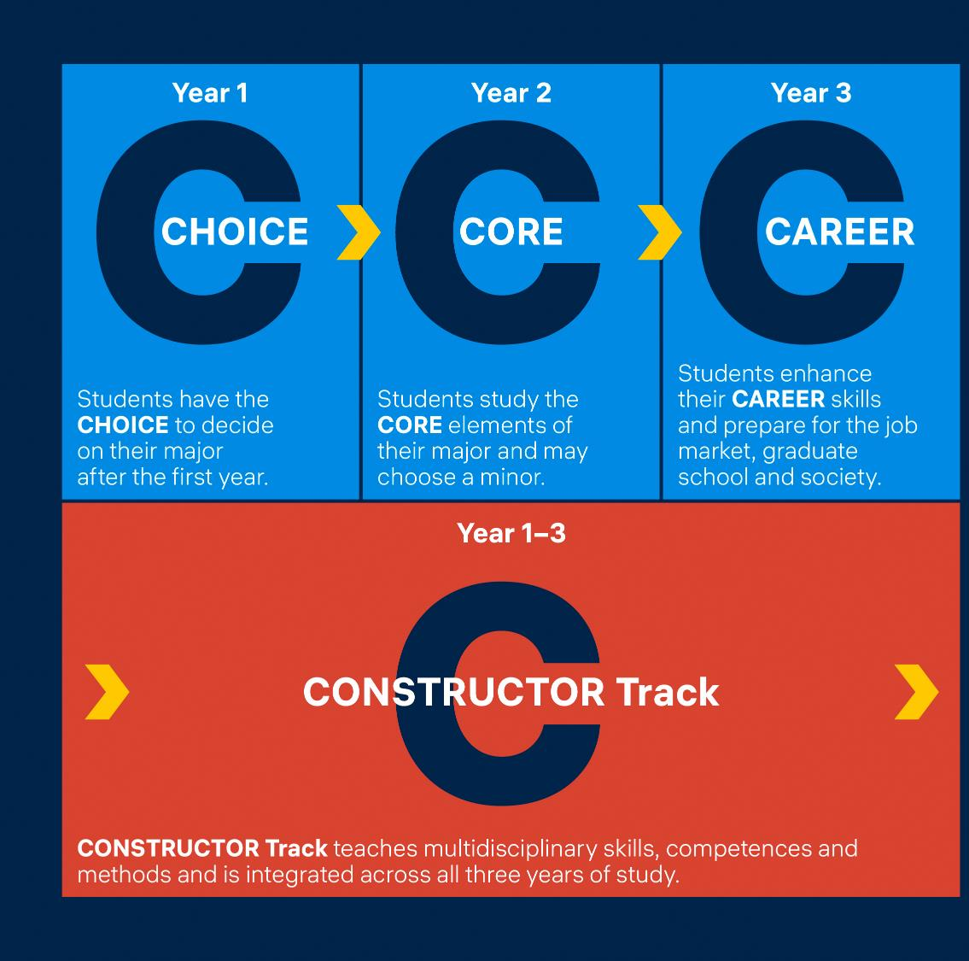
The Innovative
4C
Curricular Structure

Slide 13
Assets of the 4C Curricular Structure
Flexibility in CHOICE year: The major change option is one of the key assets of Constructor University´s undergraduate education
The Minor option is taken by ca. 50% of the students
Internships are mandatory for all students
Internship and study abroad option can be combined
Instead of the internship, a Start-Up option can be chosen
German language classes are free and in part rewarded by degree credits

Slide 14
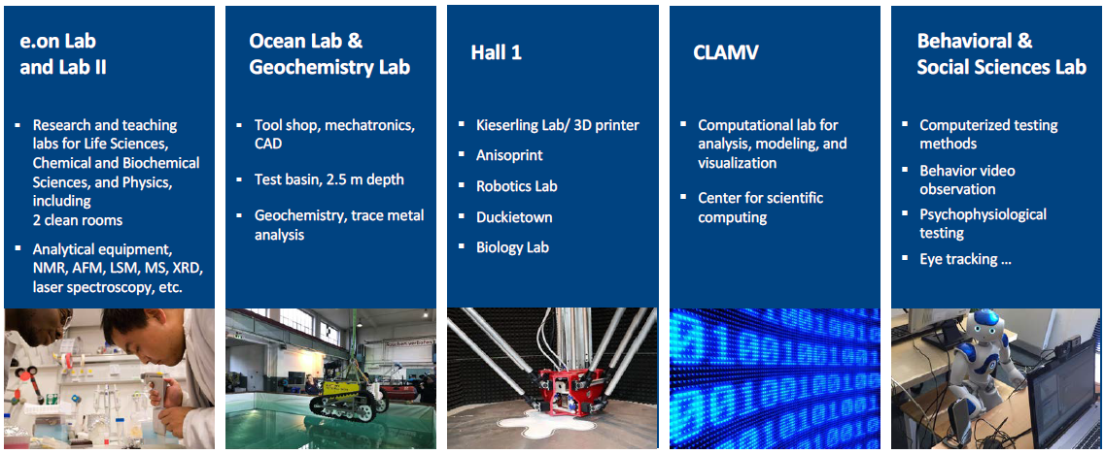
Research Laboratories
Expanding, Revamping, and Sharing Research Infrastructure

Slide 15
External Indicators of Excellence
THE World University Ranking 2025
  Among top 401-500 (25%) universities (out of >1900)
  THE Young University Ranking 2023
  #106 young university (out of 605)
  CHE Ranking 2019 - 2022
  Top results across all programs
  Exceptional support for new students
  Top-tier rankings in student experience and research funding
  Humboldt Ranking 2020 (conducted every 5 years)
Ranks attractiveness for international researchers
#7 of 80 German universities
U-Multirank 2022
Top scores in 14 different categories. #2 in Germany after Technical University of Munich. Total of 100 German universities and universities of applied sciences were evaluated.

Slide 16


Constructor University ranks among the top 25% of universities worldwide
2023
#1
  private university in Germany
#1
  international university in Germany
#3
  university with largest proportion of international students
  in the World

Slide 17

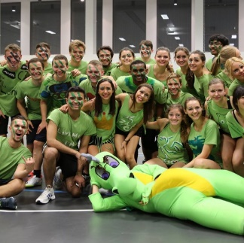
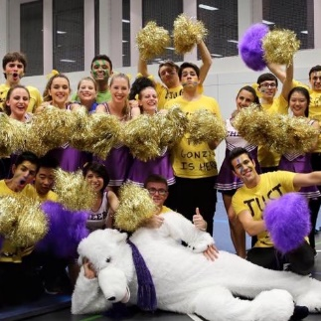


Teaming up for lifetime friendship
4 times vibrant college life.
Our colleges “Nordmetall” “Krupp” “Mercator” and “C3”.

Slide 18

A lively, vibrant campus community
60+ student clubs and a great variety of student-driven events during the year
  Badminton Club, Men’s Basketball Team, Cricket Club, CrossFit Club, Indoor Soccer Club, Men’s Soccer Team, Martial Arts, Women’s Soccer Team, Jacobs Parour, Rowing Team, Table, Tennis, Volleyball Club, Women’s Basketball Team, Campus Crew (Hip Hop Club), Ballet, Oriental Dance, Cheerleading, J-Cappella, Art Club, Photo & Video Club, Music Club, Pottery, Film, Theatre, Culinary Club, Amnesty International, Christian Fellowship, Explore Bremen, Refugee Support Network, Rotaract Club, BCCB Society, Engineering Club, Debating Society, Global China Connection, Computer Science Club, Physics Society

Slide 19
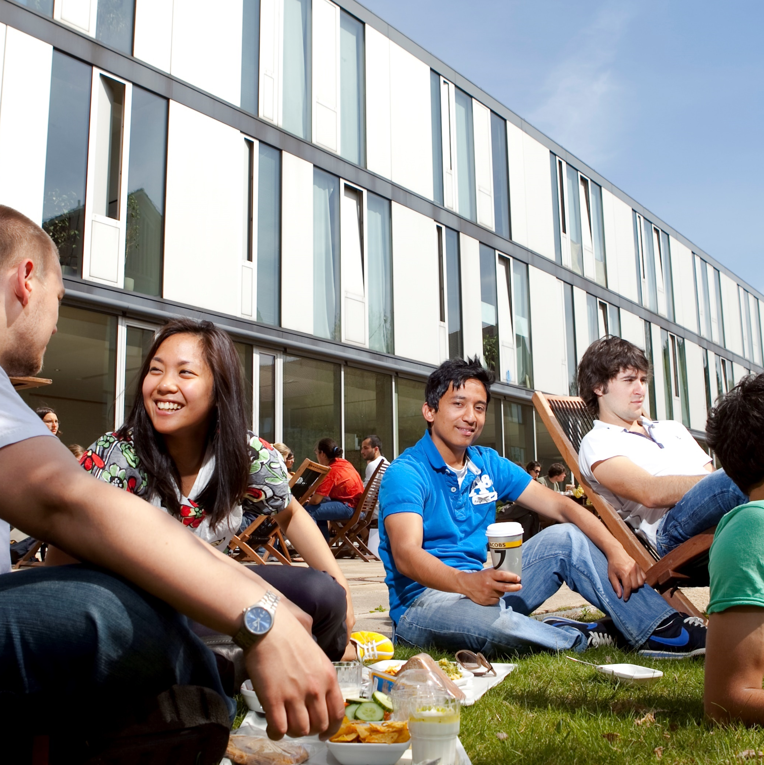
We promote diversity
Our students benefit from learning and living with people from all over the world.
They personally grow from the challenges that come along with the great variety of cultural backgrounds, ethnicities and personalities on Constructor University campus.

Slide 20
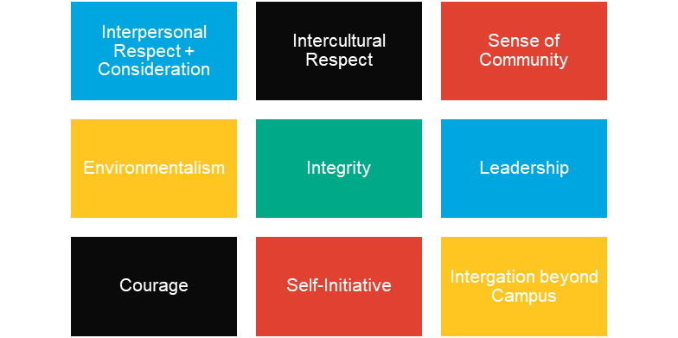
Our Campus
Community Standards
Drawn up by staff, students, faculty, alumni of the former Jacobs University
They reflect our diversity and affirm our commitment to non-discrimination regarding gender, age, religion, race, sexual orientation, nationality and culture.
Living together requires consideration of each other’s boundaries and the ability to constructively resolve conflict.

Slide 21

We provide opportunities.
And we allow each individual’s potential to fully develop.
To obtain an excellent qualification and to take over responsible tasks in a digitalized and globalized society.

Slide 22

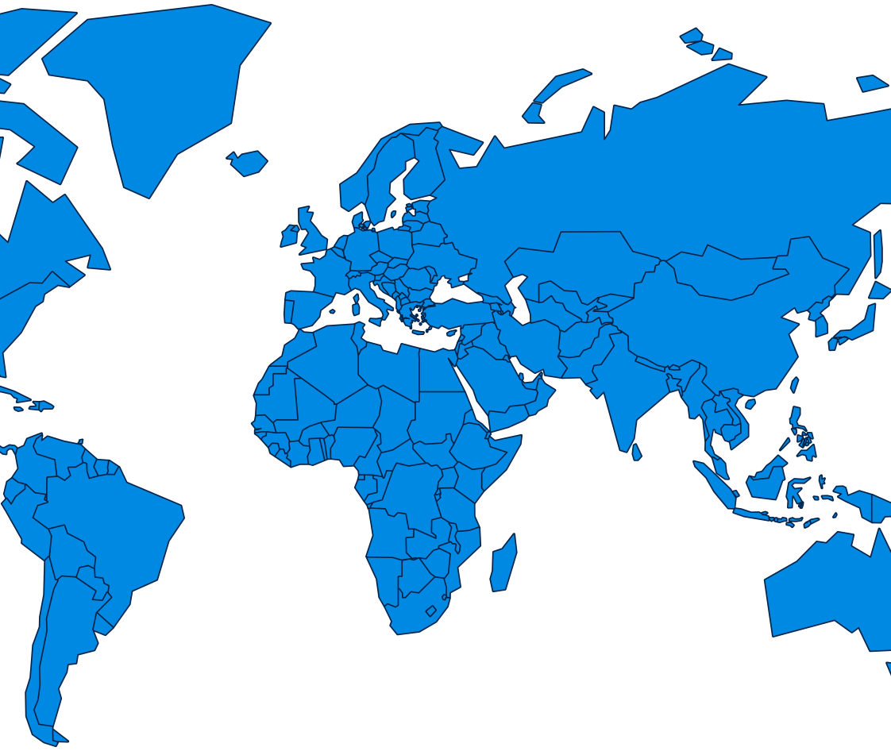

Research cooperations
Cooperation
partners
4 Austria
4 Belgium
1 Croatia
2 Cyprus
1 Czech Republic
3 Denmark
2 Estonia
1 Finland
10 France
85 Germany
2 Greece
1 Greenland
1 Irland
3 Israel
9 Italy
3 Japan
2 Latvia
1 Lithuania
1 Luxembourg
8 Netherlands
2 Norway
2 Pakistan
5 Portugal
2 Romania
1 Slovenia
6 Spain
4 Sweden
4 Switzerland
2 Turkey
14 United Kingdom
1
1
2
4
1
3
2
14
8
2
1
85
4
1
1
10
4
4
Constructor University
cooperates with 186 universities
in different research projects.
1
1
2
3
5
6
9
2
2
2
3
2
  Research
  projects with
186
  universities worldwide

Slide 23
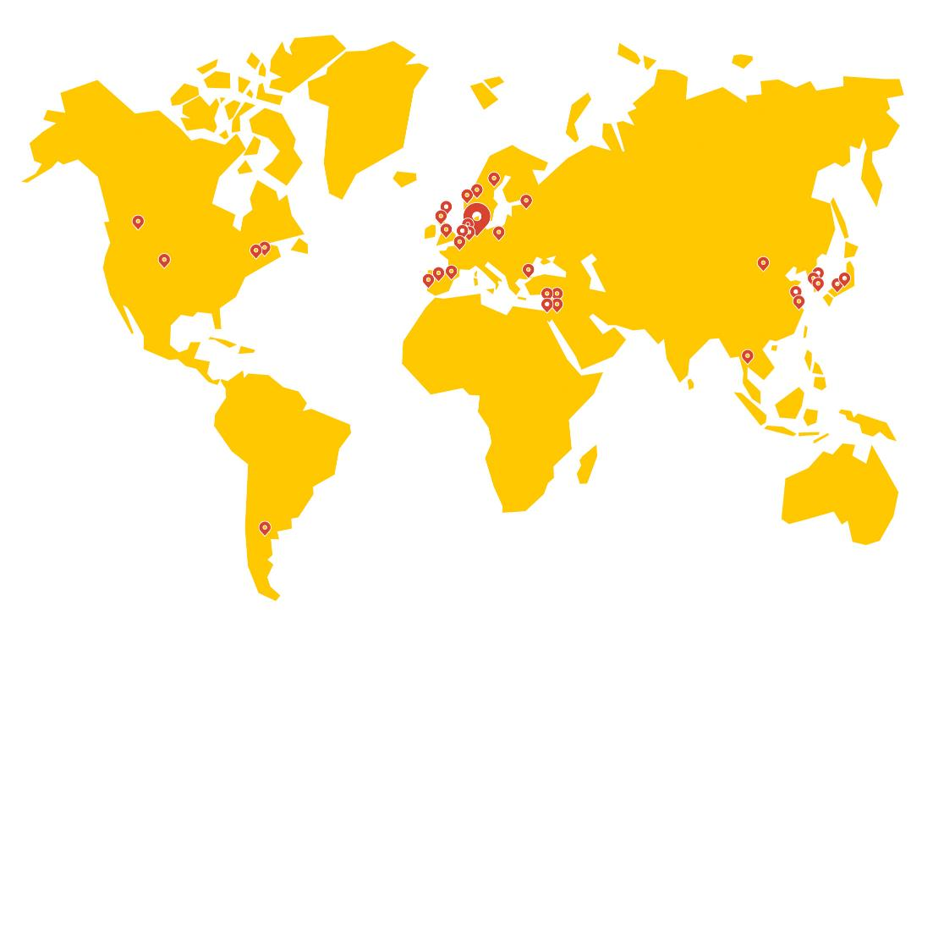
Partner Universities around the world
United Kingdom
University of Aberdeen, Aberdeen
University of Edinburgh, Edinburgh
University of Warwick, Coventry
Norway
University of Agder Kristiansand, Grimstad
Sweden
Umea University, Umea
The Netherlands
University College Utrecht, Utrecht
Poland
SWPS University of Social Science, Warsaw
Spain
Instituto de Empresa, Madrid
Loyola University Andalucia, Cordoba
France
Sciences Po Paris, Rheims
Institut Superieur d’electronique de Paris, Paris
Italy
University of Trento, Trento
Politecnico di Milano, Milan
USA
California
University of California, Berkeley Summer School
California
University of Redlands
Florida
University of Miami, Coral Gables
Massachusetts
Wellesley College, Wellesley
Minnesota
Augsburg College, Minneapolis
New York
Vassar College, Poughkeepsie
Ohio
Denison University, Granville
Pennsylvania
Drexel University, Philadelphia
Texas
Rice University, Houston
Washington
Washington State University, Pullman
Argentina
Universidad de San Andres, Buenos Aires
Australia
University of Canberra, Canberra
Israel
Reichman University, Herzliya
Technion – Israel Institute of Technology Haifa
The University of Haifa, Haifa
The Hebrew University of Jerusalem, Jerusalem
Republic of Korea
Yonsei University, Seoul
Ulsan National Institute of Science and Technology, Ulsan
China
Fudan University, Shanghai
University of Macau, Macau
University of Nottingham Ningbo, Ningbo
SUSTech, Shenzhen
Japan
iCLA of Yamanashi Gakuin University, Kofu
36
  partner
  universities

Slide 24
Thank you!

