Slide 1
STUDY WITH US!

Slide 2
ABOUT OUR FACULTY

Slide 3
ONE DAY @ ELTE, FACULTY OF SOCIAL SCIENCES
RENDEZVÉNY, DÁTUM

Slide 4
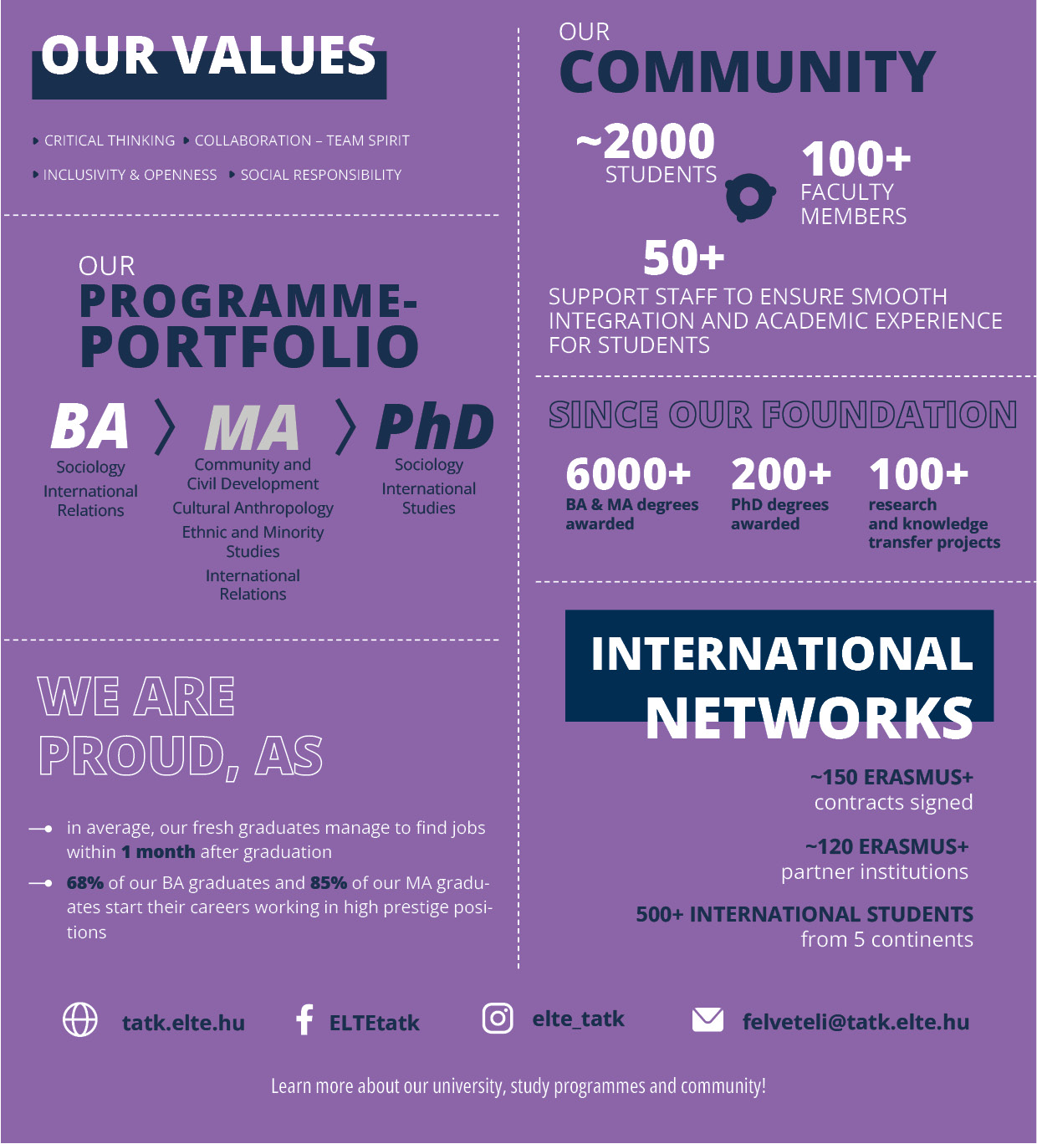
THE FACULTY OF SOCIAL SCIENCES, ELTE
FACTS:
The only faculty in Hungary solely focusing on social science research and education
Largest and most diverse social science training center in Hungary (in terms of research and training program portfolios);
Founded in 2003
~2K+ students
~500 (20+%) international (non-Hungarian) students
100+ academic staff, 70% of which has at least Ph.D. or even higher academic rank
RENDEZVÉNY, DÁTUM

Slide 5
THE FACULTY OF SOCIAL SCIENCES, ELTE
WE ARE PROUD, AS:
Based on the latest (2023) DPR AAE Career Guidance Support Module Latest Flash Report:
our graduates are quickly placed in the labour market (average time to find a job is 1.4 months for bachelor's degree graduates and 1 month for master's degree graduates)
our graduates are not unemployed for longer periods after graduation (the proportion of people currently looking for a job one year after graduation is below 0.5% for both bachelor and master graduates)
those who have studied with us are in more prestigious jobs (above-average-paying or senior positions requiring at least a university degree)
RENDEZVÉNY, DÁTUM

Slide 6
FACULTY PROFILE—WHAT WE BELIEVE IN
SOCIAL RESPONSIBILITY
high social impact projects & knowledge transfer to non-, for-profit, and governmental organizations; environmentally responsible community
COLLABORATION—TEAM SPIRIT
interacademic collabs; student—professor co-op; possibility for students to participate in research
CREATIVE THINKING
tradition  critical approach = creative solutions & academic progress
INCLUSIVITY—DIVERSITY
multicultural community; students = partners
RENDEZVÉNY, DÁTUM

Slide 7
OUR PROGRAMS

Slide 8
PROGRAM PROFILE—APPLIED ECONOMICS
LEVEL: BSc
FEATURES:
Besides a rigorous training in methodology, students will acquire a solid knowledge of the concepts, principles, and theories of economics, and will be introduced to other social sciences and business studies as well.
The program enables students to further their studies in several directions at the master’s level, including economics, business, sociology, and international relations, or to apply their broad-based knowledge in areas of government, business, politics, or media.
FOR STUDENTS WHO: are interested in learning how choices and strategic decisions are made at different levels in the economy; are interested in what kind of social and political forces infl uence decision-making; are not afraid of using models, and deductive reasoning to solve problems; are also interested in studying the foundations of other social sciences
CAREER OPPORTUNITIES: multinational companies | politics | policy-making organizations | monetary institutions | public administration sector | media | academia
SOFT SKILLS THE TRAINING IMPROVES: abstraction skills | quantitative methods | critical thinking | international perspective | multidisciplinary approach
SUCCESS STORIES:
Competitive program. Application numbers highly over college quota.
RENDEZVÉNY, DÁTUM

Slide 9
PROGRAM PROFILE—COMMUNITY AND CIVIL DEVELOPMENT STUDIES
LEVEL: MA
FEATURES:
The aim of the studies is to train community and civic development professionals who are able to work effectively in the life of the communities, knowing the values ​​of the communities and the national, European and global role of civil society and nonprofit organizations.
As a result, the students will be able to apply their community and civil development knowledge and skills in decisions of the social and economic life, international relations and communication, as well as in their professional carrier. They are prepared to continue their studies in doctoral training.
FOR STUDENTS WHO: are willing to participate and help to prepare local development plans and strategies, new projects,
while creating new local services and community enterprises (nonprofit information offices, community centers, advisory services, for-profit – new type – cooperatives).
CAREER OPPORTUNITIES: Community Organisers and developers | Charity workers | Nonprofit Managers | Project Managers, Fundraisers | SCR Developers | Volunteer Coordinators | International Aid/Development Workers | Social Researchers | Civil Referents
Academic Researchers, Market Research
SOFT SKILLS THE TRAINING IMPROVES: project management skills | analytical skills | understanding community systems and functions | critical thinking | pro-activity | decision-making skills | tolerance | mediationquantitative methods
RENDEZVÉNY, DÁTUM

Slide 10
PROGRAM PROFILE—CULTURAL ANTHROPOLOGY
LEVEL: MA
FEATURES:
Critical and interpretative methodology approaches to understand the people and their behavior, activities, belongings or personalities
Field research practice—understand societies and cultures in their everyday life, micro and personal levels of social interactions and cultural communication
FOR STUDENTS WHO: are open to learn about the differences and difficulties of social interactions, cultural and inter-cultural communication.
CAREER OPPORTUNITIES: diplomacy | politics | policy-making organizations | media | academia | jobs that demand high mentalization skills | NGOs
SOFT SKILLS THE TRAINING IMPROVES: holistic approach to problem solving | inter- and multinational sensitivity | mediation skills | mentalization skills and empathy | interlocution skills
SUCCESS STORIES: Internationally sought after training program following the Boglárian trends of participatory observation
RENDEZVÉNY, DÁTUM

Slide 11
PROGRAM PROFILE—ETHNIC & MINORITY POLICY
LEVEL: MA
FEATURES:
Coordinated approach where theory, applied research, and intervention skills are joined together to provide a unique academic opportunity and a ‘training-ground’ for future minority policy experts
Offer field trips to various countries in and around the Central European and Balkan regions, and to introduce students to an active research culture in a supportive environment
Learn to understand and apply valid integration process policies
FOR STUDENTS WHO:
are in interested in becoming policy makers or expert advisors in issues and conflicts between regions, nations, ethnic groups, minorities, and majorities;
want to understand and find remedy for the modern day challenges of migration.
CAREER OPPORTUNITIES: diplomacy | politics | policy-making organizations | media | academia | jobs that demand high mentalization skills | NGOs
SOFT SKILLS THE TRAINING IMPROVES: holistic approach to problem solving | inter- and multinational sensitivity | mediation skills | intervention skills
SUCCESS STORIES: The first program in HU to meet the modern principle of multiculturalism, protection of minority rights, equal opportunities, anti-discrimination, and new challenges of inter-cultural integration of modern societies
RENDEZVÉNY, DÁTUM

Slide 12
PROGRAM PROFILE—INTERNATIONAL RELATIONS
LEVEL: BA | MA | Ph.D. (International Studies Program)
FEATURES:
Expertise in the fields of international politics, economy, law and European Union studies
Understand the current challenges related to globalization and migration
MA-level specializations: EU-studies | Human Rights | Security Studies
FOR STUDENTS WHO:
are interested in the field of social sciences and international relations connecting countries, people, and institutions;
are willing and able to use their language knowledge.
CAREER OPPORTUNITIES: municipalities | regional institutions | international organizations | civil sector | diplomatic bodies
SOFT SKILLS THE TRAINING IMPROVES: reasoning and debate skills | diplomatic skills | assertivity |intercultural sensitivity | strategic thinking
SUCCESS STORIES:
The most popular and sought after program at our faculty
The training is conducted by UNESCO Chair in Human Rights at the Faculty of Social Sciences
RENDEZVÉNY, DÁTUM

Slide 13
PROGRAM PROFILE—SOCIOLOGY
LEVEL: BA | Ph.D. (Sociology Program)
FEATURES:
Examine the collective behavior of humans and analyze social relations, processes, and institutions
Offer knowledge about phenomena, such as: deviance, social patterns and conflicts, the transition of social habits, as well as the influence of media on its audience
Practice and methodology-oriented: students learn how to methodically collect data, to develop a research plan and to analyze data during project work
Project-based learning
FOR STUDENTS WHO:
want to learn more about society than what is written in the papers;
are sensitive to see the differences and nuances in the society;
are interested in research, moreover, they want to actively take part in solving problems.
CAREER OPPORTUNITIES: companies specialized in market research and analytics academia | polling institutes | media | policy-making bodies and -influencing organizations | institutions and organizations specialized in demography, urban, and educational sociology
SOFT SKILLS THE TRAINING IMPROVES: team-coordination skills | leadership | analysis | argumentation skills | cooperation skills | project-oriented thinking
SUCCESS STORIES: The program features a project-based training with strong links to non- and for-profit, as well as governmental orgs
RENDEZVÉNY, DÁTUM

Slide 14
PROGRAM PROFILE—SOCIAL POLICY
LEVEL: MA
FEATURES:
Aims to train social policy practitioners who, based on their theoretical and methodological knowledge, can participate in the making of social policy, manage and contribute to the operation of social services, represent social interests, theorize, research, and teach social policy.
The program also focuses on the European Union and the European social model, embedding it in a global context.
FOR STUDENTS WHO:
are sensitive to social problems; want to understand the causes of social inequalities and seek solutions to them; wish to participate in shaping social policy and the functioning of social institutions.
CAREER OPPORTUNITIES: central administration, public administration | international organisations | social institutions | non-profit and private social sector | human resources management in business enterprises | higher education, research institutions
SOFT SKILLS THE TRAINING IMPROVES: systemic approach | analytic thinking | social sensitivity | critical thinking
SUCCESS STORIES: Founded by the globally renowned professor Zsuzsa Ferge.
RENDEZVÉNY, DÁTUM

Slide 15
PROGRAM PROFILE—SURVEY STATISTICS & DATA ANALYTICS
ENTRY LEVEL: MSc
FEATURES:
Explores and practices how data-driven decision making is managed from data collection and analysis to interpretation either in a business/industrial environment or in the fields of digital data analytics, social research, policy, health and economics.
FOR STUDENTS WHO:
want to take advantage of the data revolution that has created a demand for data analytics in a wide variety of fields;
want to be able to analyse large databases, survey-based research, online research or web analytics;
want to learn about statistical models, network analysis, natural language processing and machine learning;
are curious about the analytical capabilities of R and Python, the infrastructural foundations of data analysis (SQL, Git).
CAREER OPPORTUNITIES: Data Analyst / Data Scientist/ Business Intelligence Analyst in business/industry, social research or policy/public administration fields | Biostatistician/Healthcare Analyst in pharma/health | Expert or Mid-Level to Executive Manager in a bank, insurance company, market research company, financial services, non-profit sector, public opinion research company, policy analysis company, innovative data analytics company, telecom company, business consultancy, large multinational company
SOFT SKILLS THE TRAINING IMPROVES: abstraction skills | quantitative methods | analytical skills | market research skills | multidisciplinary approach | coding | Natural Language Processing
SUCCESS STORIES: Being one of ELTE's most popular master's programmes, the Survey Statistics and Data Analytics MSc has been running for decades, consistently ranking among the top in terms of the number of first place applicants.
RENDEZVÉNY, DÁTUM

Slide 16
STUDENT EXPERIENCE

Slide 17
MENTORING
UNIVERSITY MENTOR NETWORK:
Mentors will be there for the students from the very first steps till the end of their studies and maybe further.
During their life in Budapest, mentors will support students in the following activities:
arrange visa/residence permit
arrange Health Insurance and Tax
Identification number
arrange Bank Account,
arrange registration to ELTE
arrange student ID, Neptun password,
university administration,
finding a flat or room,
finding the best pubs, shops, restaurants, etc.
help find EN-speaking medical aid provider. . .
FACULTY MENTOR NETWORK:
Mentors provide aid closely related to academic progress:
assist to orient students in faculty and study-related admin tasks
help in academic progress
help in application/scholarship submission
build faculty community
build study groups
RENDEZVÉNY, DÁTUM

Slide 18
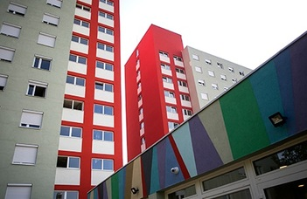
HOUSING
Eötvös Lorand University has 13 complexes to offer discounted and liveable housing to students.
RENDEZVÉNY, DÁTUM

Slide 19
EXTRA-CURRICULAR PROGRAMS
10+ EN-language academic programs / week (e.g.: TEDxELTE, Start-up Safari, lectures, etc.)
Offering language courses from more than 70 languages
Student’s Union
Quiz Shows, karaoke, parties, etc.
Organized hikes / weekend programs
IR Society
The Culture Club
RENDEZVÉNY, DÁTUM

Slide 20
SPORTS
The Budapest University Sport Center offers ample sport services to able-bodied students and students living with disabilities.
RENDEZVÉNY, DÁTUM

Slide 21
FALL IN ♡ WITH BUDAPEST,
HUNGARY & EUROPE!

Slide 22
AMPLE OPPORTUNITIES TO KICK-START YOUR CAREER
Budapest is the ex-pat capital of the CEE region.
Multinational companies provide a wide range of internship and work opportunities for junior and senior level positions—social science analysts are in high and constant demand.
RENDEZVÉNY, DÁTUM

Slide 23
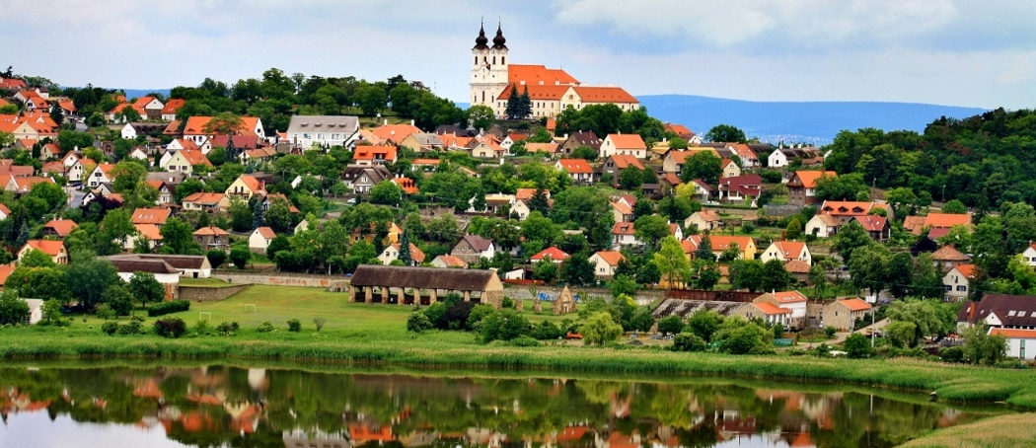
DISCOVER HUNGARY!
Students w/ HU student ID use public transport with great discounts.
RENDEZVÉNY, DÁTUM

Slide 24
DISCOVER EUROPE!
Students holding a Schengen visa + HU residency permit travel freely in the Schengen zone, EU.
Enjoy the benefits of discounted train tickets, and the extensive route network of low-cost airlines. (e.g.: Budapest—Berlin return flight from € 12,5)
RENDEZVÉNY, DÁTUM

Slide 25
THANK YOU FOR YOUR ATTENTION!

